Slide 1

MTC Presents TechFuse 1.0 AIML Bootcamp
17,18,19 April

Slide 2
TABLE OF CONTENTS
01
02
03
04
REGRESSION
CLASSIFICATIONS
CLUSTURING
SUPERVISED LEARNING

Slide 3
What is REGRESSION?
A regression is a statistical technique that relates a dependent variable to one or more independent (explanatory) variables.
A regression model is able to show whether changes observed in the dependent variable are associated with changes in one or more of the explanatory variables

Slide 4
What is LINIAR REGRESSION?
Linear regression analysis is used to predict the value of a variable based on the value of another variable. The variable you want to predict is called the dependent variable. The variable you are using to predict the other variable's value is called the independent variable.

Slide 5
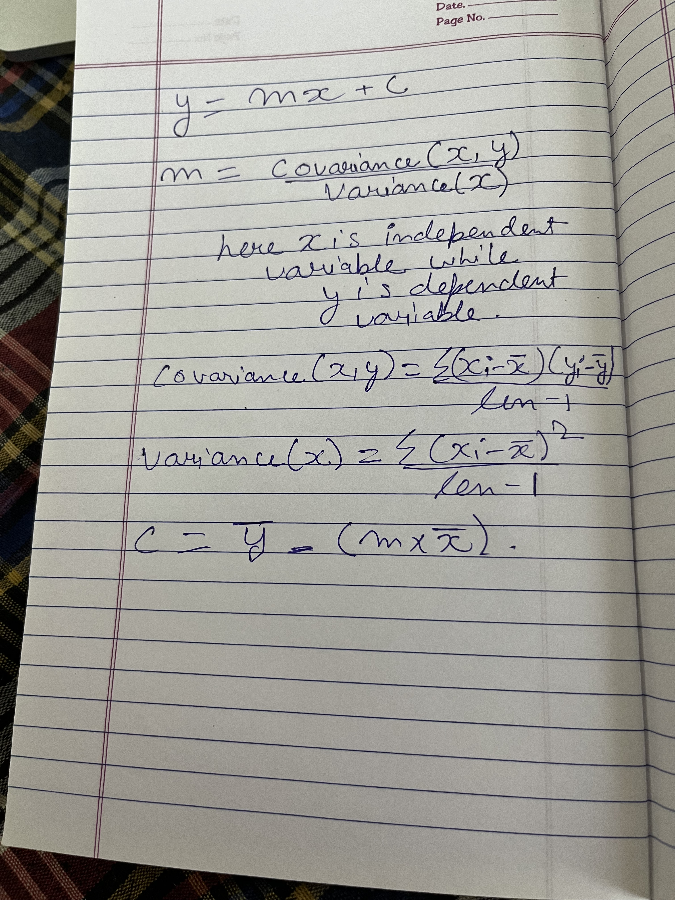

Slide 6
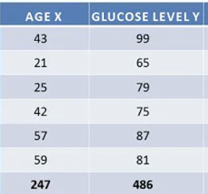

Slide 7

FINAL EQUATION
Y = 65.14 + 0.38X

Slide 8

WHAT IS LOGISTIC REGRESSION
This type of statistical model (also known as logit model) is often used for classification and predictive analytics. Logistic regression estimates the probability of an event occurring, such as voted or didn’t vote, based on a given dataset of independent variables. Since the outcome is a probability, the dependent variable is bounded between 0 and 1. In logistic regression, a logit transformation is applied on the odds—that is, the probability of success divided by the probability of failure. This is also commonly known as the log odds, or the natural logarithm of odds, and this logistic function is represented by the following formulas:
Logit(pi) = 1/(1+ exp(-pi))
ln(pi/(1-pi)) = Beta_0 + Beta_1*X_1 + … + B_k*K_k

Slide 9
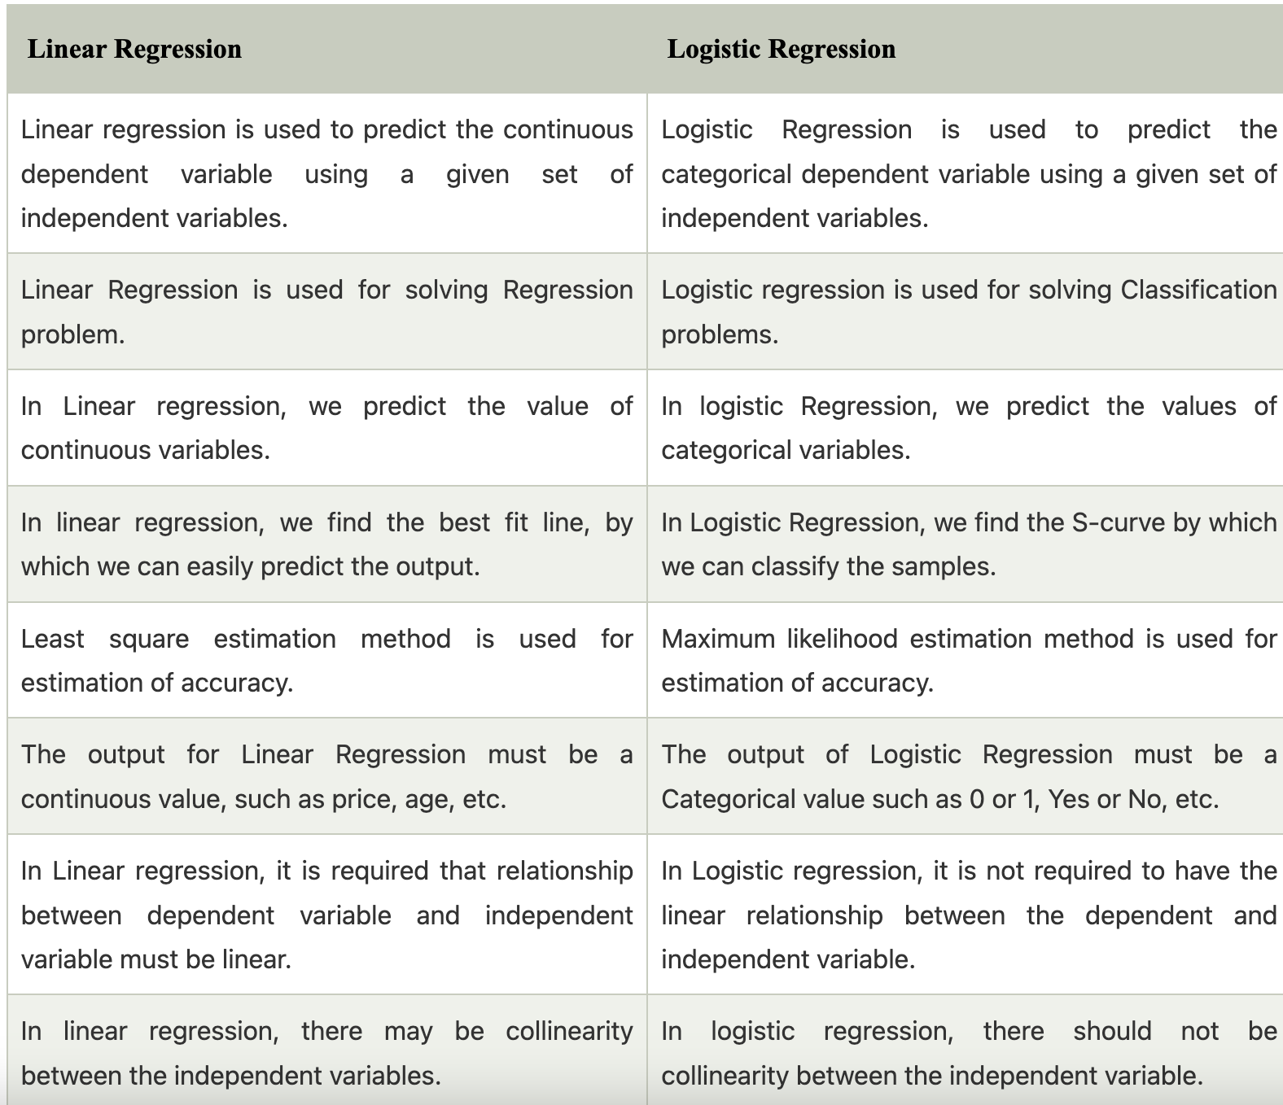
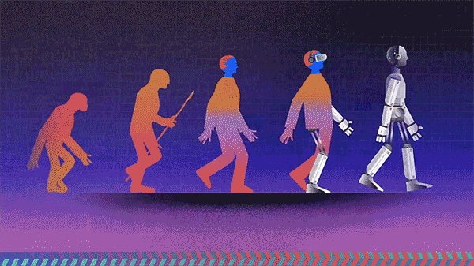
DIFFRENCE BETWEEN LOGISTIC REGRESSION AND LINIAR REGRESSION

Slide 10
CLASSIFICATION
In machine learning, classification is a predictive modeling problem where the class label is anticipated for a specific example of input data. For example, in determining handwriting characters, identifying spam, and so on, the classification requires training data with a large number of datasets of input and output

Slide 11
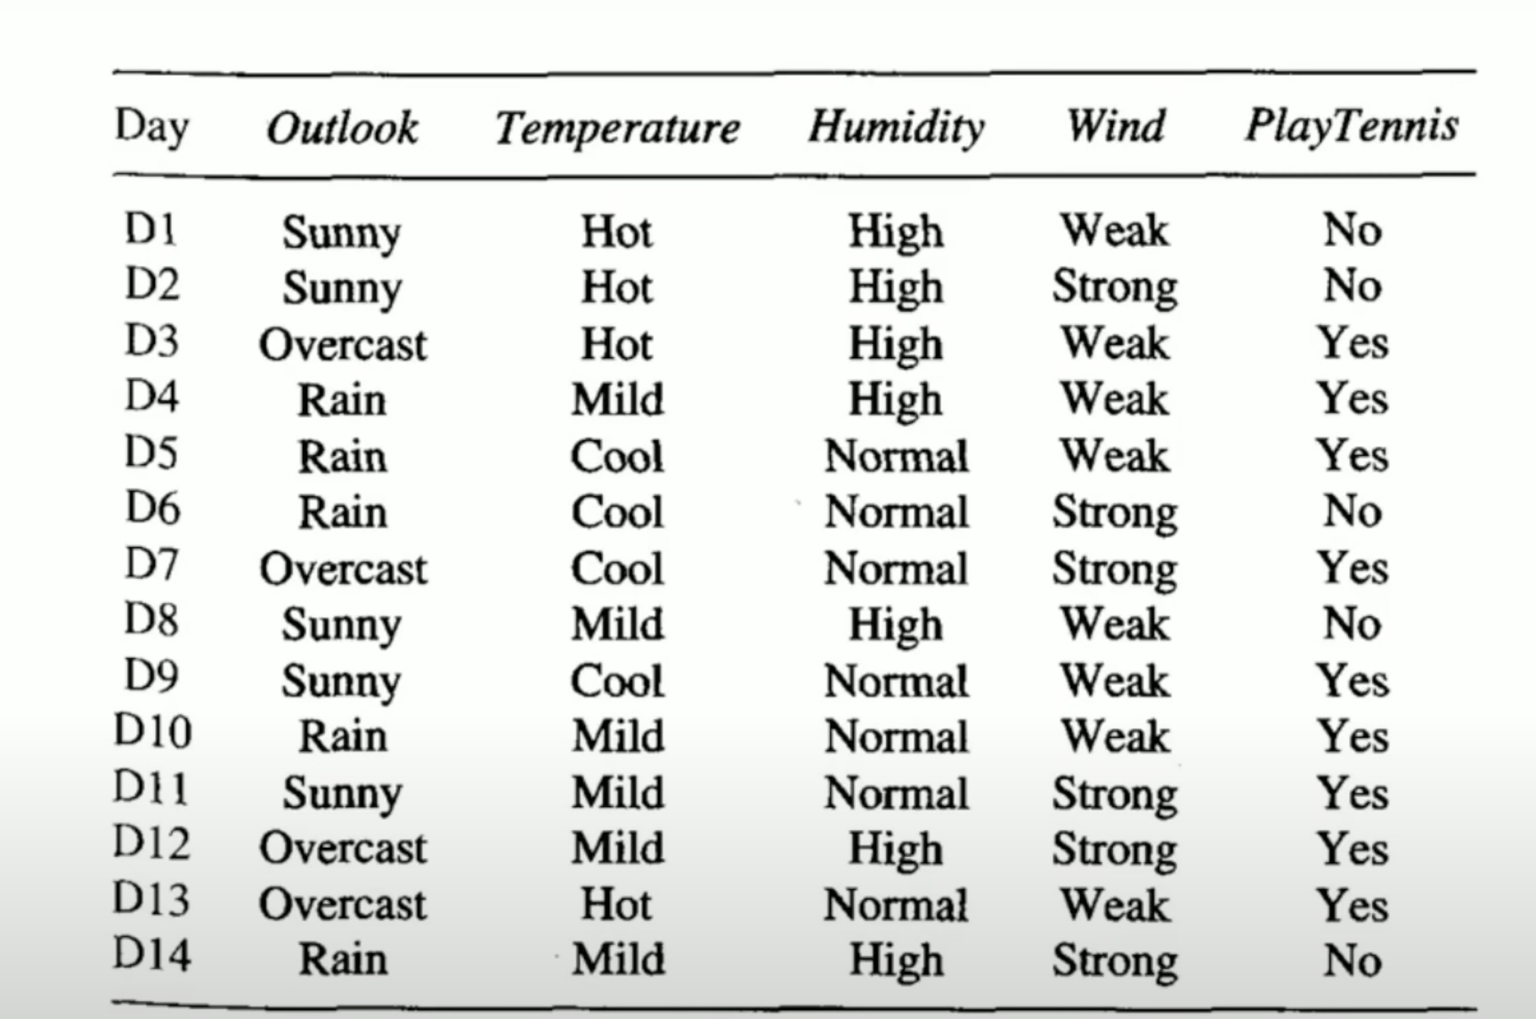
NAIVE BAYES’S ALGLORTHM

Slide 12
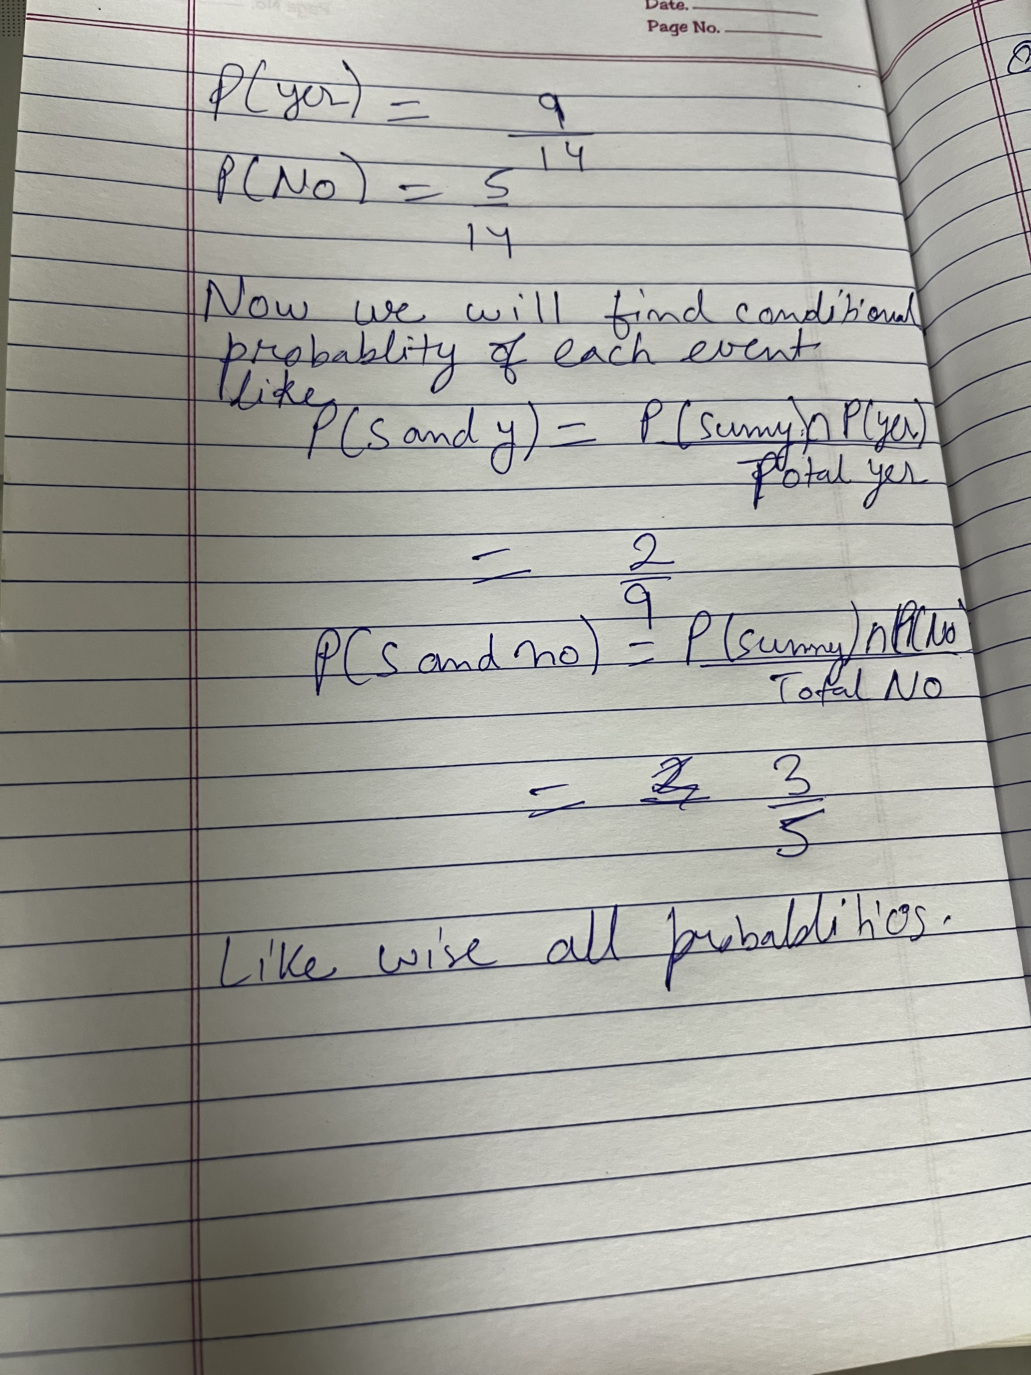
IMG_1369.HEIC

Slide 13
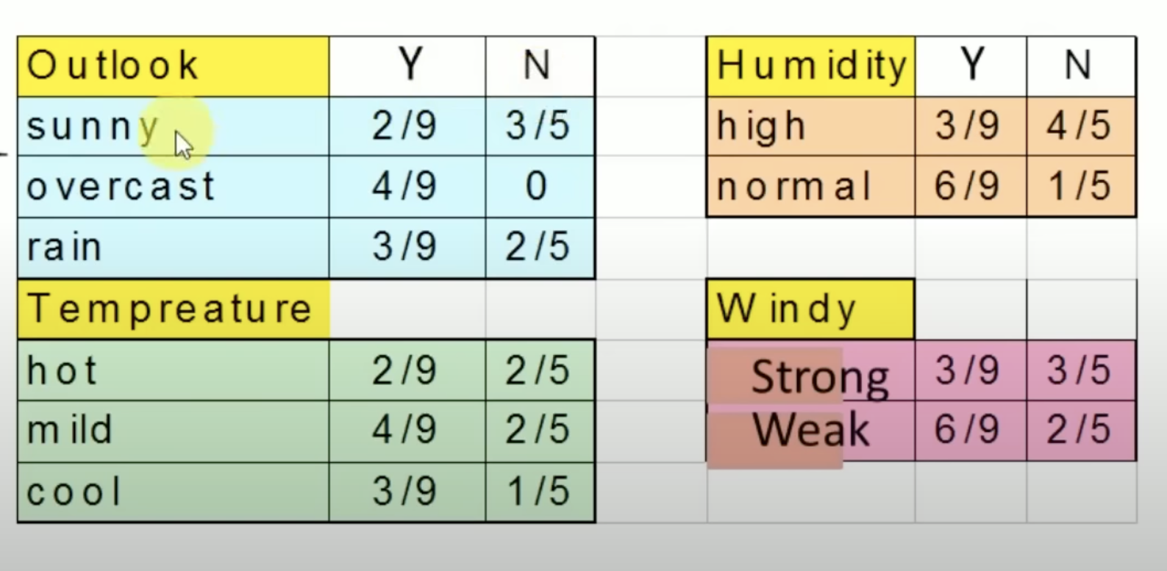

Slide 14
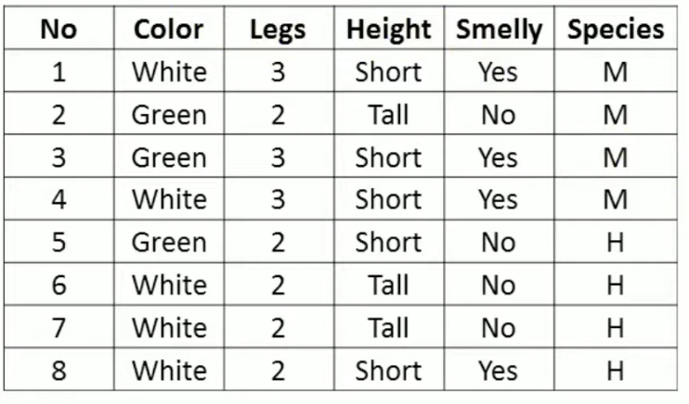

Slide 15
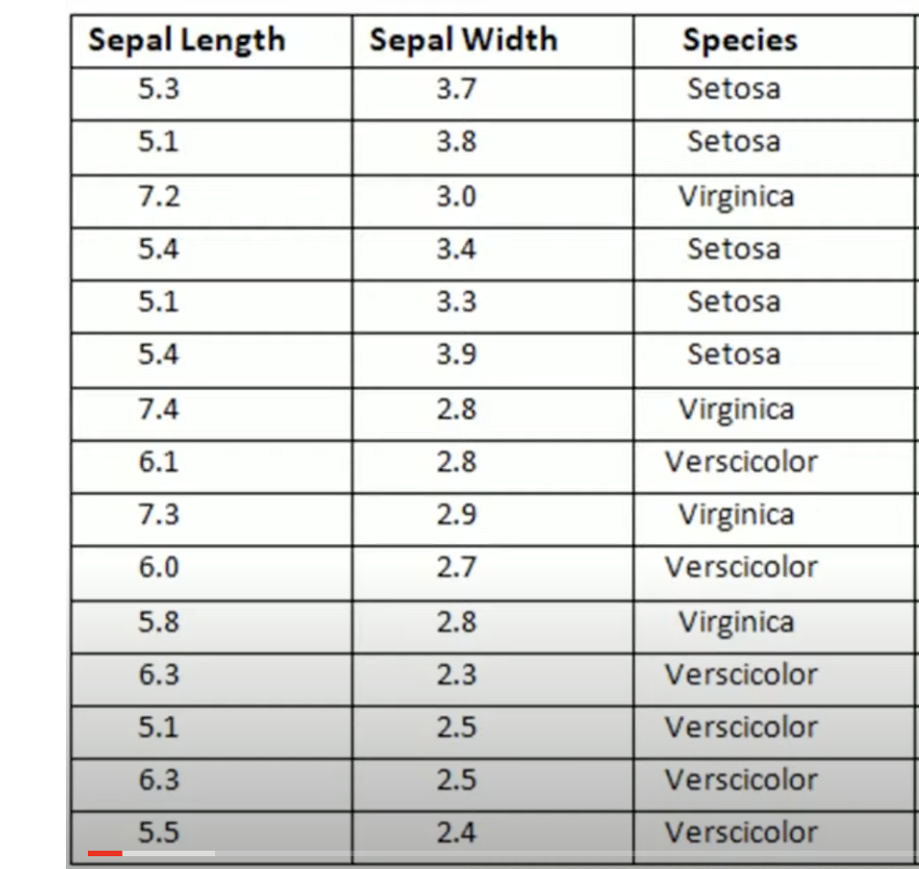
K NEAREST NEIGHBOUR

Slide 16
FIND THE SPECIES FOR FLOWER WITH SEPAL LENGTH 5.2 AND SEPAL WIDTH 3.1

Slide 17
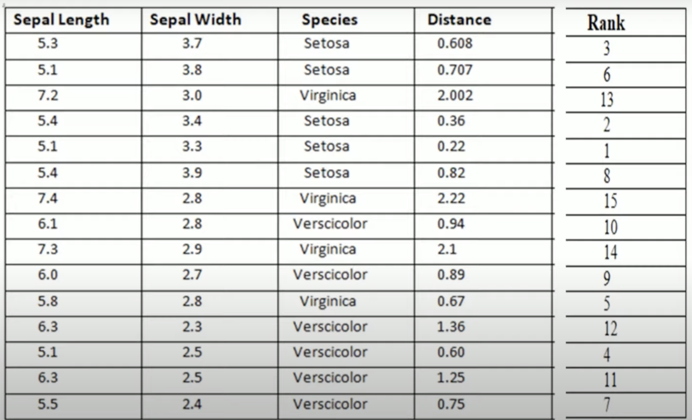

Slide 30
THANKS!
@upesmtc
MICROSOFT TECHNICAL COMMUNITY

